Slide 1
Machine Learning for data science and business intelligence – 8IAR403
By Kévin Bouchard Ph.D.
Professor in artificial intelligence & machine learning
Laboratoire d'Intelligence Ambiante pour la reconnaissance d'activités (LIARA)
Université du Québec à Chicoutimi
www.Kevin-Bouchard.ca

Slide 2
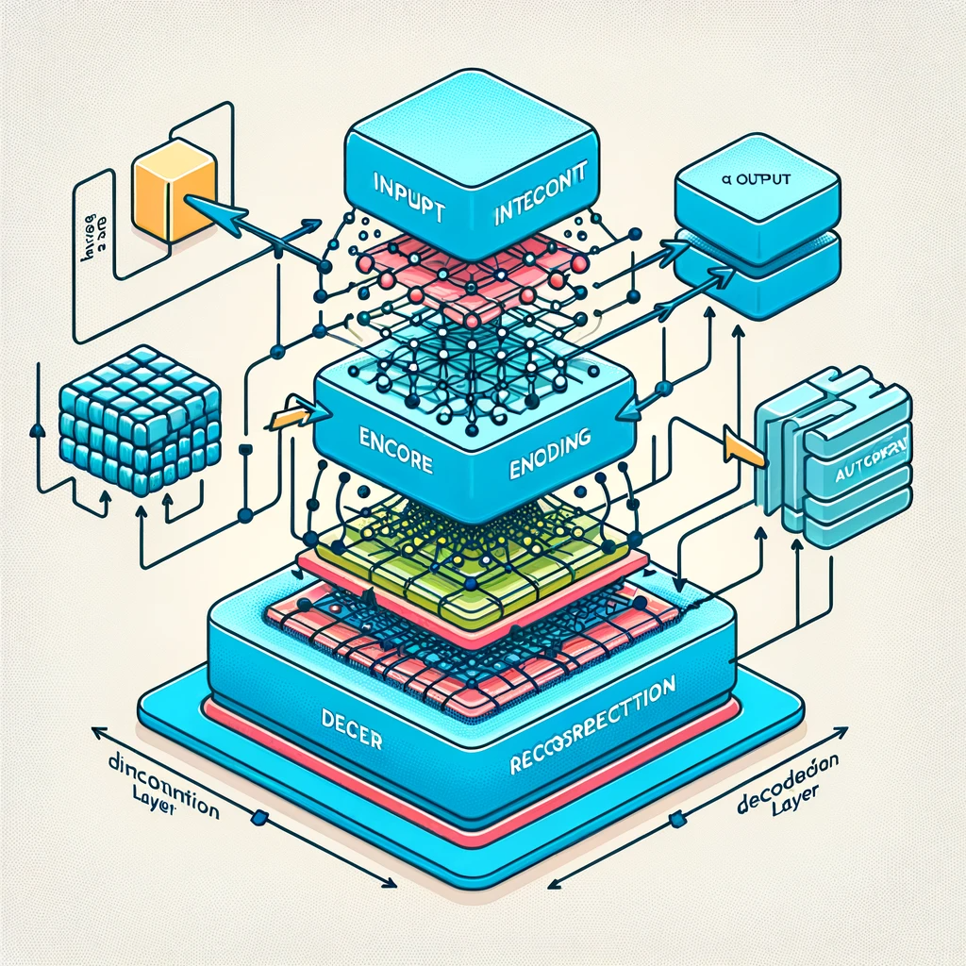



Summary of lesson #16
You will learn about:
Autoencoders and their role in unsupervised learning, particularly for tasks like dimensionality reduction, feature learning, and denoising
Manifold learning and how high-dimensional data can often be represented in lower dimensions, preserving intrinsic structures

Slide 3
Autoencoder
An autoencoder is a type of artificial neural network used to learn efficient codings of unlabeled data, usually for the purpose of dimensionality reduction
Basic autoencoders do a job comparable to PCA
They are designed and trained to encode an input in a compressed form
In the presence of a degraded version, they can reconstruct the input
Thus, it is a data compression technique
The term almost always refers to neural networks

Slide 4
Autoencoder
The autoencoders are
Data Specific: They only compress similar data (trained for faces, does not work for cats)
Lossy: The decompressed outputs are degraded
Automatically trained: From data examples. They are unsupervised or more specifically, they perform self-learning, as with Word Embedding.

Slide 5
Autoencoder
A neural network with 3 or more layers
Same number of units in the input and output
The hidden layer(s) have fewer
They work with a loss function: the reconstruction loss
...and an optimizer (stochastic gradient descent)
In fact, they are not very good for compression...
...but they generalize well!

Slide 6
Applications of Autoencoders
Dimensionality Reduction
We can use encoding to reduce the dimensionality of our data
Similar to RBM, and compared to previous methods, this can be much more powerful
Feature Extraction
We can use autoencoders to automatically extract features
It's more or less a good method…
Pretraining for Neural Networks
The weights learned by autoencoders can be used as a starting point for the training of other neural networks
Notes:
Génération de données
Representation learning
Sécurisation des données

Slide 7
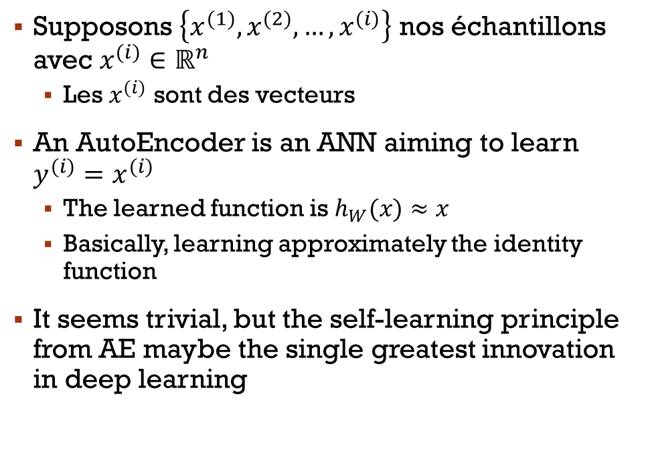
Autoencoder
Supposons $\left\{x^{(1)},x^{(2)},…,x^{(i)}\right\}$ nos échantillons avec $x^{(i)}∈ℝ^{n}$
Les $x^{(i)}$ sont des vecteurs
An AutoEncoder is an ANN aiming to learn $y^{(i)}=x^{(i)}$
The learned function is $h_{W}(x)≈x$
Basically, learning approximately the identity function
It seems trivial, but the self-learning principle from AE maybe the single greatest innovation in deep learning

Slide 8
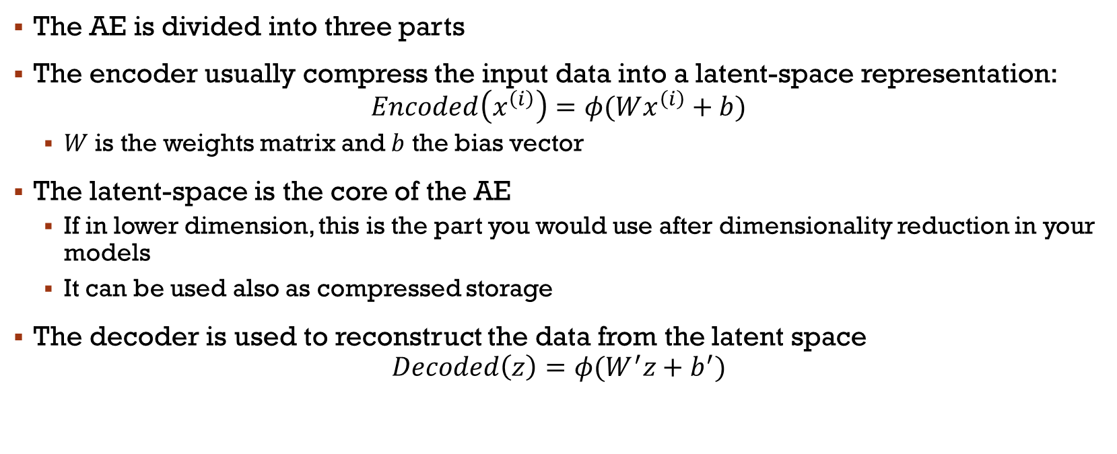
How does it work?
The AE is divided into three parts
The encoder usually compress the input data into a latent-space representation:
$$Encoded\left(x^{\left(i\right)}\right)=φ(Wx^{\left(i\right)}+b)$$
$W$ is the weights matrix and $b$ the bias vector
The latent-space is the core of the AE
If in lower dimension, this is the part you would use after dimensionality reduction in your models
It can be used also as compressed storage
The decoder is used to reconstruct the data from the latent space
$$Decoded\left(z\right)=φ(W^{′}z+b^{′})$$

Slide 9
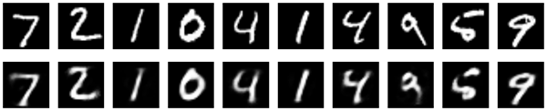
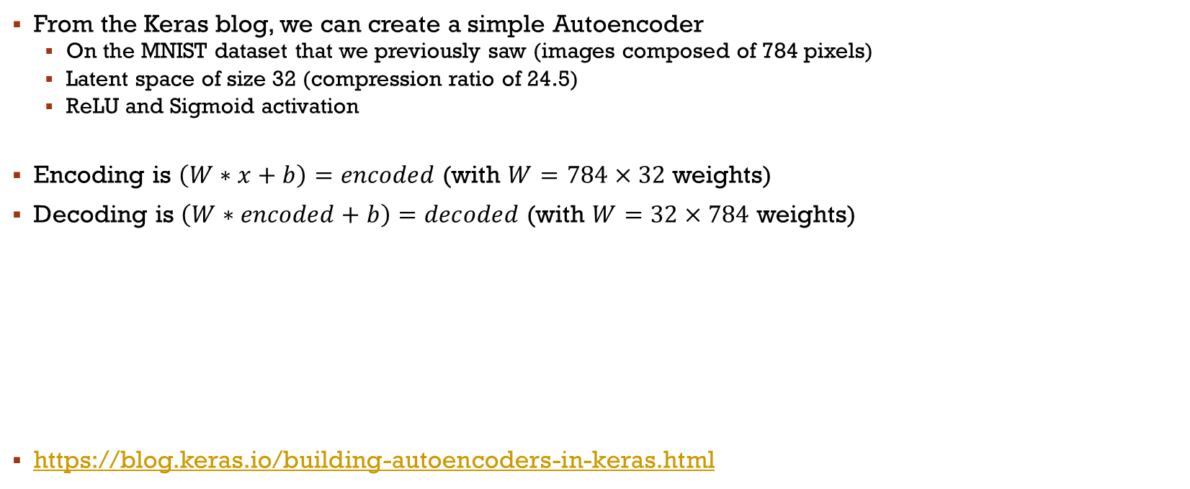
Autoencoder Example
From the Keras blog, we can create a simple Autoencoder
On the MNIST dataset that we previously saw (images composed of 784 pixels)
Latent space of size 32 (compression ratio of 24.5)
ReLU and Sigmoid activation
Encoding is $\left(W∗x+b\right)=encoded$ (with $W=784×32$ weights)
Decoding is $\left(W∗encoded+b\right)=decoded$ (with $W=32×784$ weights)
https://blog.keras.io/building-autoencoders-in-keras.html
Notes:
Prendre le temps avec le code

Slide 10
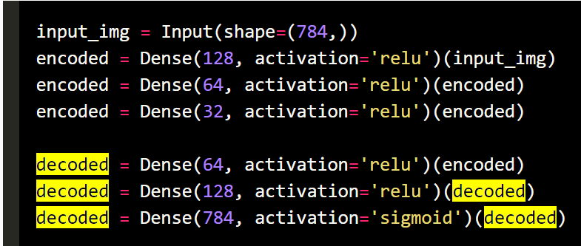
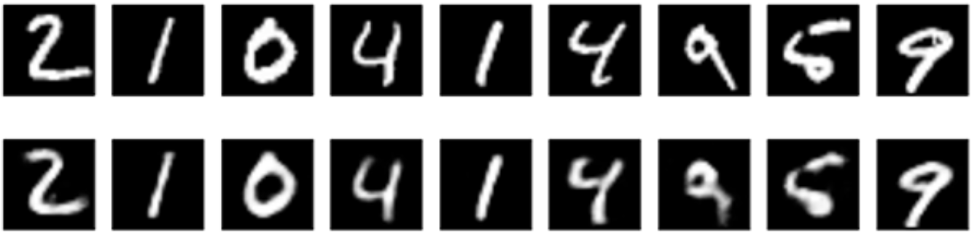
Deep autoencoder
We can very easily modify our autoencoders to create deeper architectures
In this case 3 layers of encoders, 3 layers of decoders
Here with the same example the error is less than 1% after 100 Epochs

Slide 11
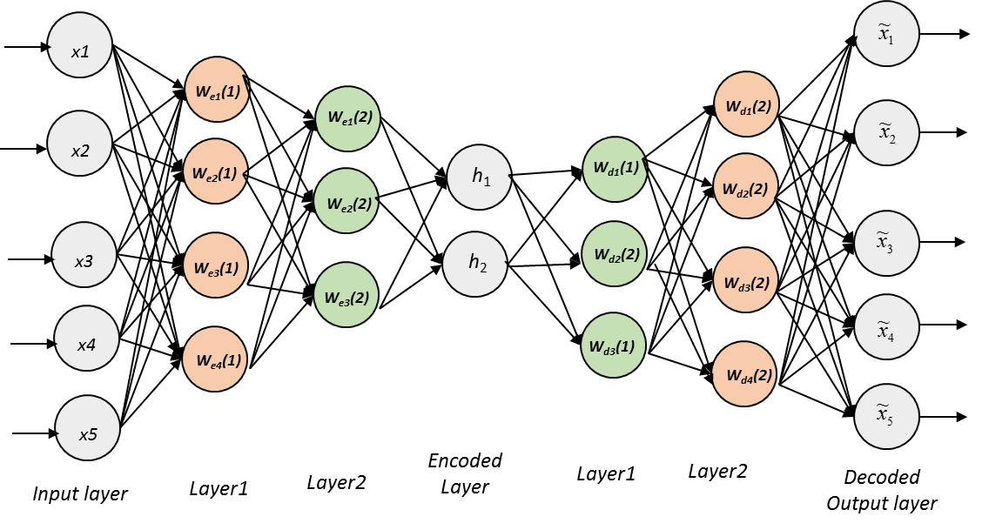
Deep Autoencoder
Notes:
Prendre le temps au tableau d’expliquer que c’est du self-supervised… avec dessin pour loss

Slide 12
Types of Autoencoders
Denoising Autoencoders:
These are trained to remove noise from data
They are given corrupted input data and are trained to recover the original, uncorrupted data
We’ll see them in the following slides
Sparse Autoencoders:
By adding a sparsity penalty on the encoded representations, sparse autoencoders can discover more robust features
Variational Autoencoders (VAEs):
These are generative models that not only learn the encoding of the data but also model the distribution of the latent variables
They can be used to generate new synthetic data

Slide 13
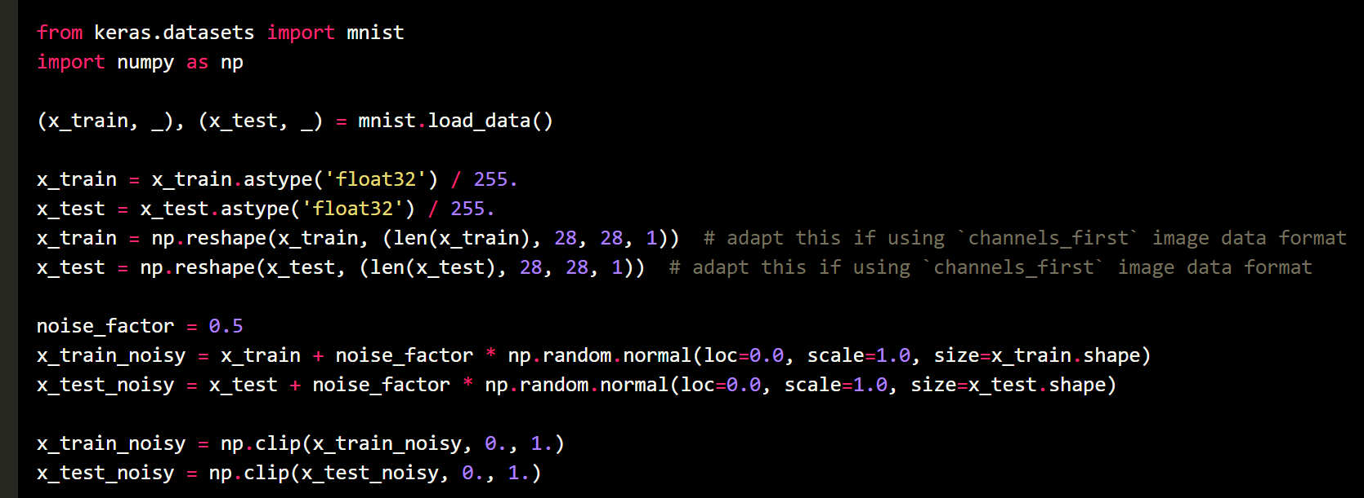
Denoising
We are going to train the autoencoder to map noisy digit images to clean digit images
We take MNIST and add a Gaussian noise matrix

Slide 14
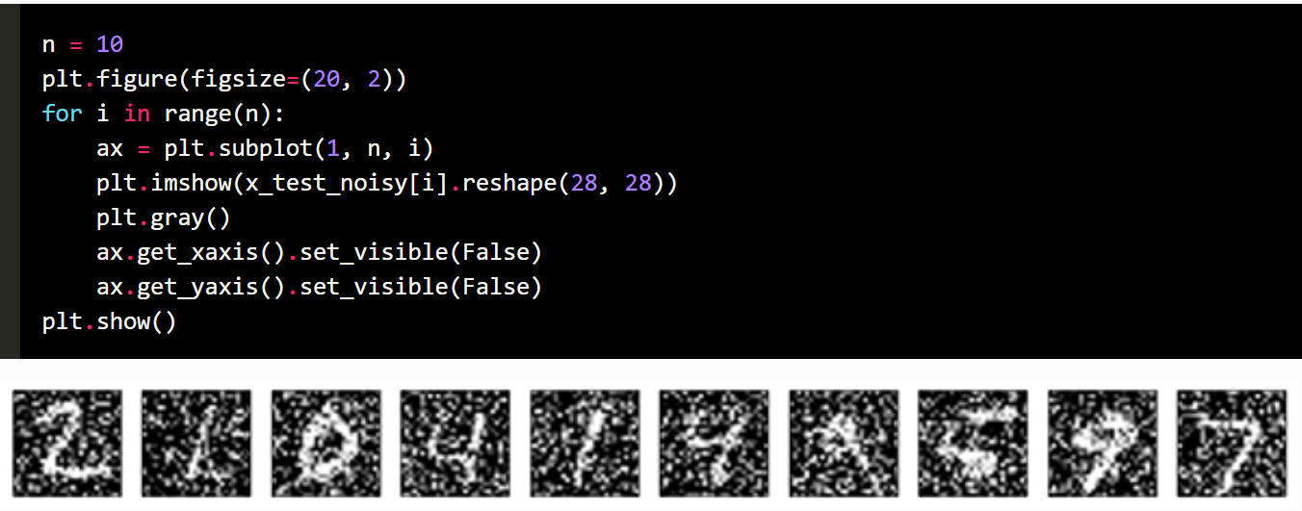
Denoising

Slide 15
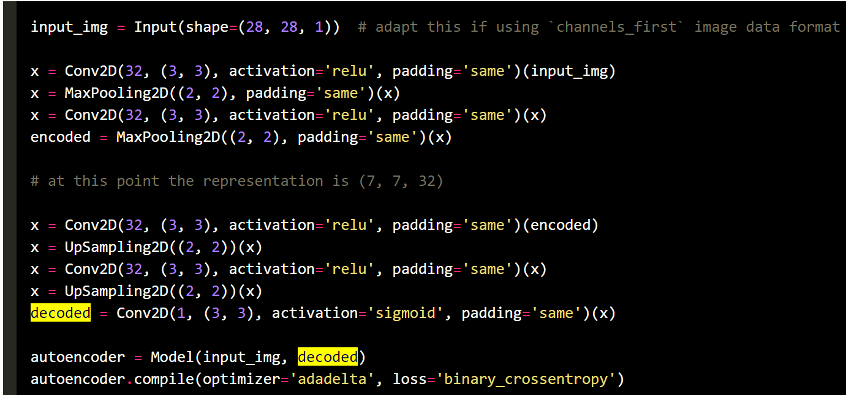
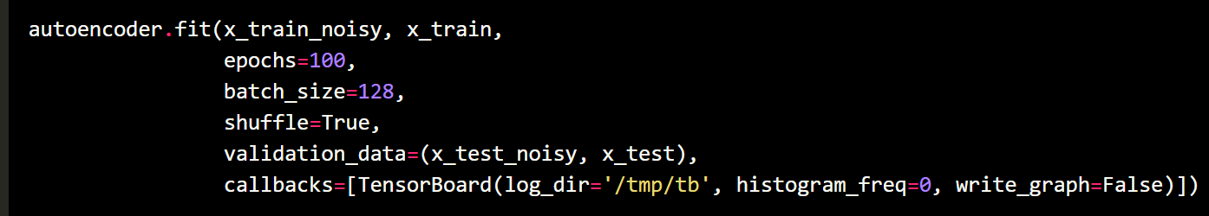
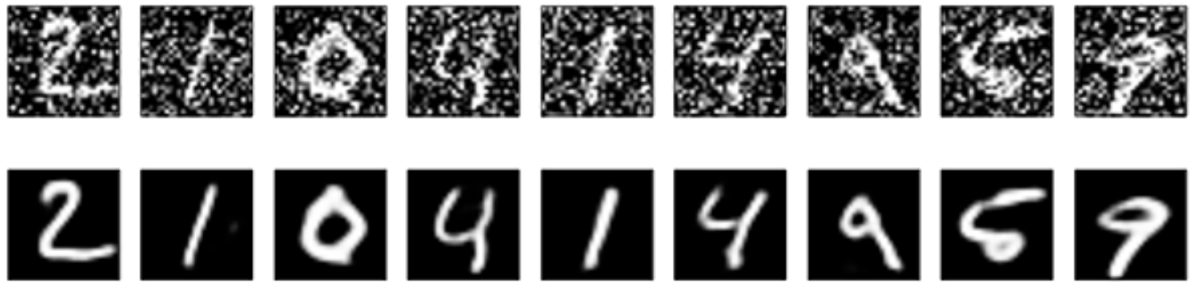
Denoising
The model:
Training:
Results:
Notes:
Tester activation différente
Et Conv transpose

Slide 16
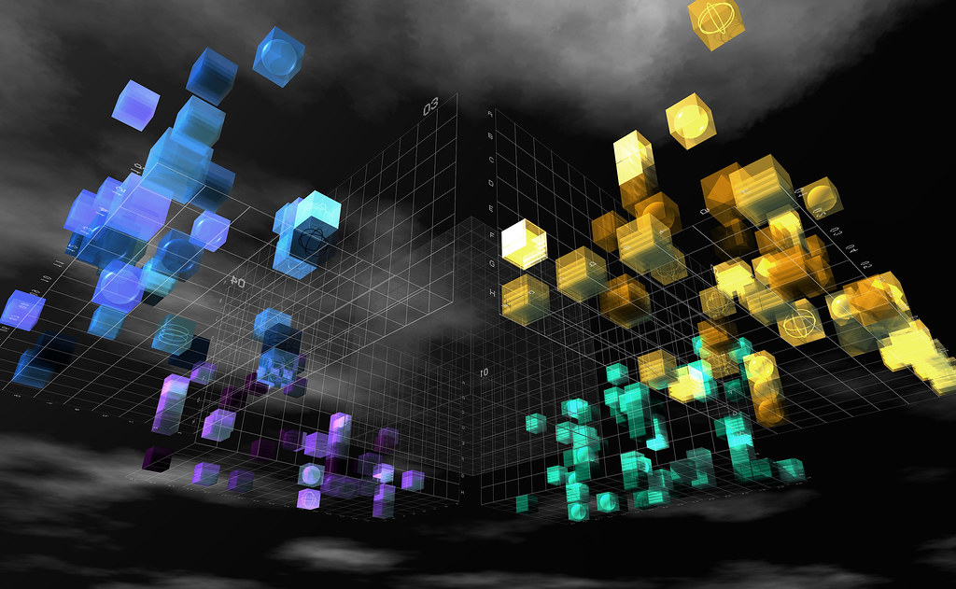

Visualization?
Dimensionality reduction is not only useful for learning itself!
It can also be used to visualize complex data!
Notes:
Manifold learning: approche de réduction de dimensionalité non-linéaire (contrairement à celles qu’on a vu jusque là)
Un manifold est une structure géométrique inhérente aux données
ATTENTION AU SCALING!!! (NN donc distances)
ATTENTION au données aberrantes -> peut détruire le modèle

Slide 17
Manifold Learning
Manifold learning is a type of unsupervised learning that is particularly well-suited for discovering the low-dimensional structure within high-dimensional data
The manifold hypothesis suggests that high-dimensional data often lie on a low-dimensional manifold within the high-dimensional space
Manifold learning can be used to perform dimensionality reduction
However, the most common use is to visualize the high dimensional data in 2D or 3D for interpretability/analysis

Slide 18
Manifold Learning
In the real world, there are a few drawbacks to those methods compared to what we saw until now:
Scalability: Many manifold learning algorithms are computationally intensive and do not scale well to large datasets
Hyperparameter Selection: Choosing the right parameters (e.g., the number of neighbors) can be critical and non-trivial
Non-Linear Mappings: The mappings found by manifold learning are often non-linear and complex, which can make the transformations difficult to interpret and reverse
The main algorithms are: Locally Linear Embedding, IsoMAP, t-SNE, and UMAP

Slide 19
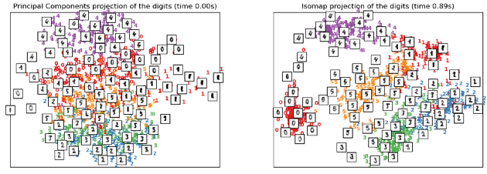
Isomap
One of the first approaches (Isometric Mapping) and is an extension of Kernel PCA
Searches for nearest neighbors (BallTree structure)
Dijkstra algorithm for shortest path
Matrix decomposition into eigenvalues
Notes:
Performe mieux que PCA sur MNIST
Rapidement les hyper: n voisins, n_components (dimension), algo de config (laissez défaut)

Slide 20
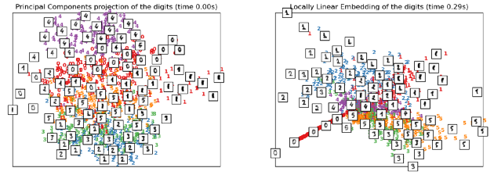
Locally Linear Embedding
LLE looks for a lower-dimensional projection that preserves distances in a local neighborhood
It's a bit like a set of PCAs that are globally compared to form a non-linear latent space
Only step 2 differs (we construct a weight matrix)
Notes:
Souvent une haute densité au centre avec rayons…
Plus rapide que Isomap dû à la stratégie divisé pour reigner (caluls locaux)
Avec hyper « method=‘modified’ », devient ModifiedLLE->LLE peut avoir des problèmes de régularisation dans certains cas très spécifiques
MLLE est plus lent
HessianLLE->même chose mais différemment

Slide 21
t-distributed Stochastic Neighbor Embedding (t-SNE)
Is one of the most popular methods to visualize data
t-SNE starts by calculating the pairwise distances between all points in the high-dimensional space
It then converts these distances into probabilities that represent similarities
In the lower-dimensional space, t-SNE uses a Student’s t-distribution to calculate a similar probability distribution
t-SNE minimizes the Kullback-Leibler (KL) divergence between the two distributions with respect to the positions of the points in the map
https://scikit-learn.org/stable/auto_examples/manifold/plot_lle_digits.html
Notes:
State of the art avec UMAP
SNE and UMAP have the same principle and workflow: create a high dimensional graph, then reconstruct it in a lower dimensional space while retaining the structure. t-SNE moves the high dimensional graph to a lower dimensional space points by points. UMAP compresses that graph.
PCA maximize la variance, pas t-SNE!

Slide 22
t-SNE vs LLE et IsoMap
t-SNE is excellent for local structures while others seek a global structure in low dimension
It will tend to output clusters of similar instances
However, t-SNE is very slow, especially compared to PCA
The algorithm is stochastic and therefore multiple executions may yield different representations
The global structure is not preserved, which is why it is less suitable for feature selection
Notes:
Isomap tries to preserve geodesic distance, or distance measured not in Euclidean space but on the curved surface of the manifold.
Locally Linear Embeddings can be thought of as representing the manifold as several linear patches, in which PCA is performed on.
t-SNE takes more of an ‘extract’ approach opposed to an ‘unrolling’ approach, but still, like other manifold learning algorithms, prioritizes the preservation of local distances by using probability and t-distributions.
Voir exemple: https://github.com/aviolante/sas-python-work/blob/master/tSneExampleBlogPost.ipynb
Parler rapidement de l’exemple concret en recherche

Slide 23
Main References
Russell S., Norvig P., Artificial Intelligence: A Modern Approach. Prentice-Hall, Englewood Cliffs, 2021.
Aggarwal, C. C., Neural networks and deep learning. Springer, 2023.
Goodfellow I., Bengio Y., Deep Learning. The MIT Press, 2016.
Raschka S., Python Machine Learning, Packt Publishing, 2015.
Sutton R.S., Barto A.G., Reinforcement Learning: An Introduction, A Bradford Book, 2021.
Witten I.H., Frank E., Hall M.A., Pal C. Data Mining: Practical Machine Learning Tools and Techniques, Morgan Kaufmann, 2016.

